Slide 1
ARTIFICIAL INTELLIGENCE & CONNOISSEURSHIP
COCHRANE ADAMS
FINE ART AGENTS
Charles Cochrane

Slide 2
COCHRANE ADAMS
FINE ART AGENTS
Connoisseurship
Society of Dilettanti, 18th Century London
Aesthetics, Archaeology, Grand Tour
Neoclassicism, Royal Academy

Slide 3

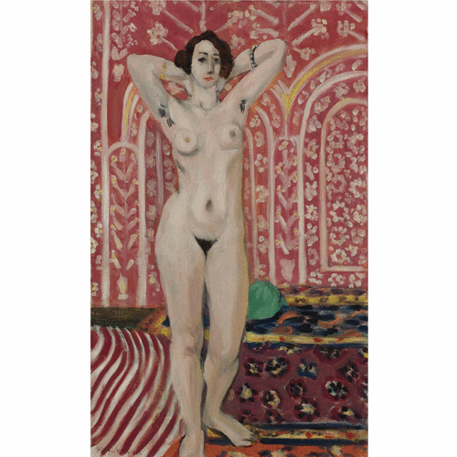
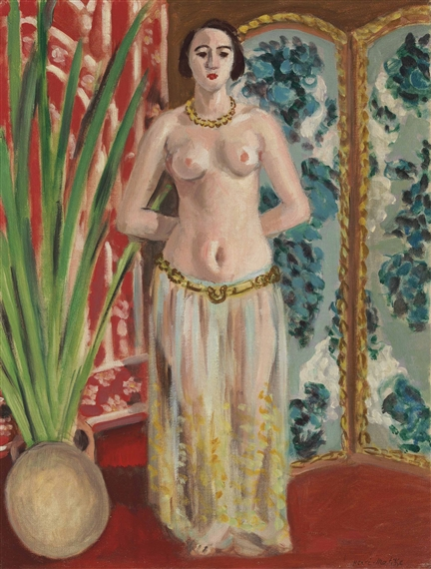
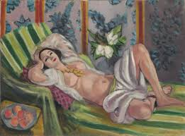

Slide 4
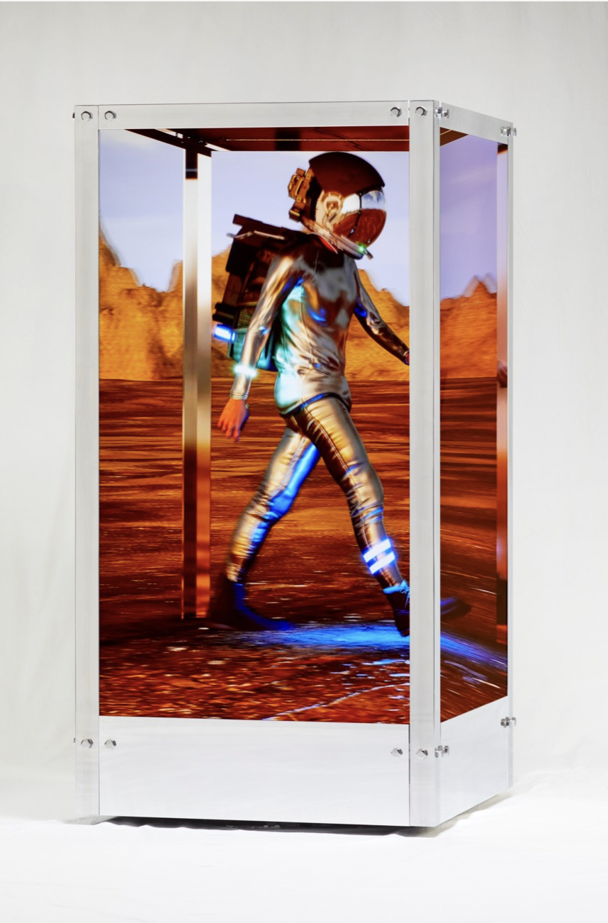
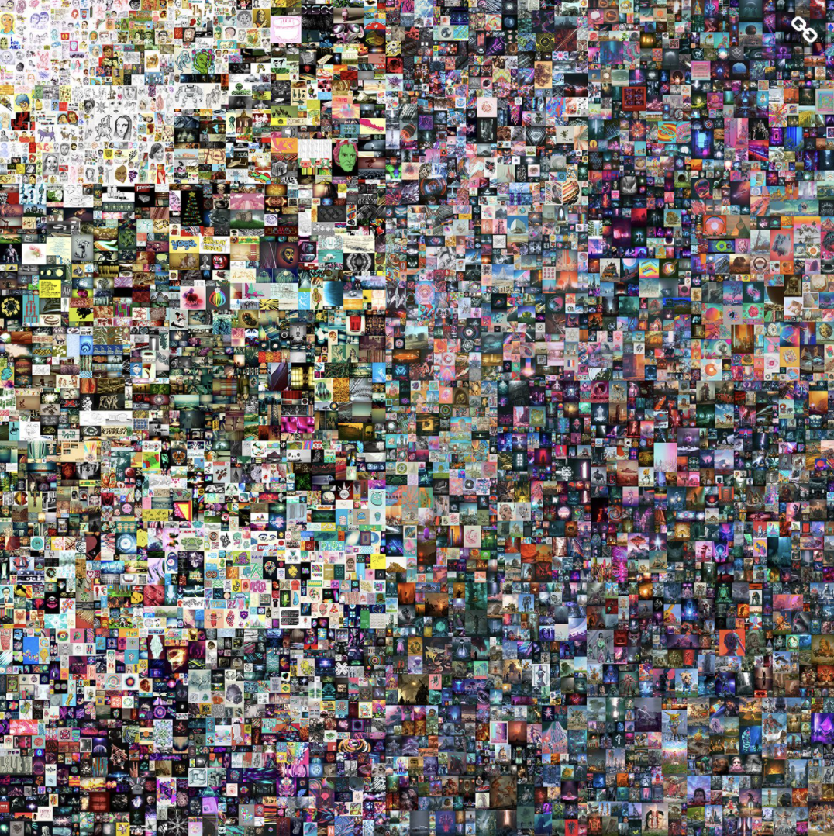
Christie’s, 21st Century Evening Sale
New York, 09 November 2021
Lot 7a, Beeple (B. 1981), Human One, 2021
kinetic video sculpture
Estimate on request. Lot sold: 28,985,000 USD
(inclu. Premium)
Christie’s, online
New York, 11 March 2021
Lot 1, Beeple, Every Days: The First 5000 Days One, 2021
Estimate unknown. Lot sold: 69,356,250 USD
(inclu. Premium)
Image © Christie’s

Slide 5
COCHRANE ADAMS
FINE ART AGENTS
  AI & ART
  Pick images and amend
  2. Existing Images and Tagging meaning/labelling
  MOMA Algorhythms – Black Box
  3. Politics/Control/Bias/Corporations – 1984/Brave New World?
  4. Real/Unreal/Artist/Machine
  5. Artists – People/Machine?
  6. Connoisseurship?

Slide 6
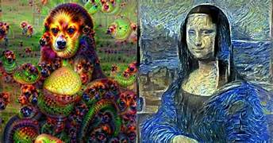

Slide 7
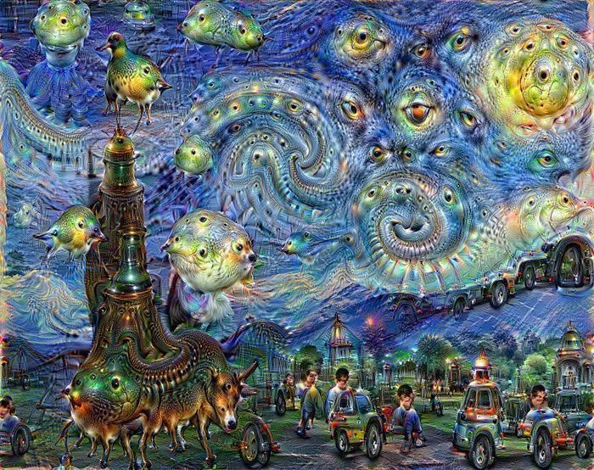

Slide 8
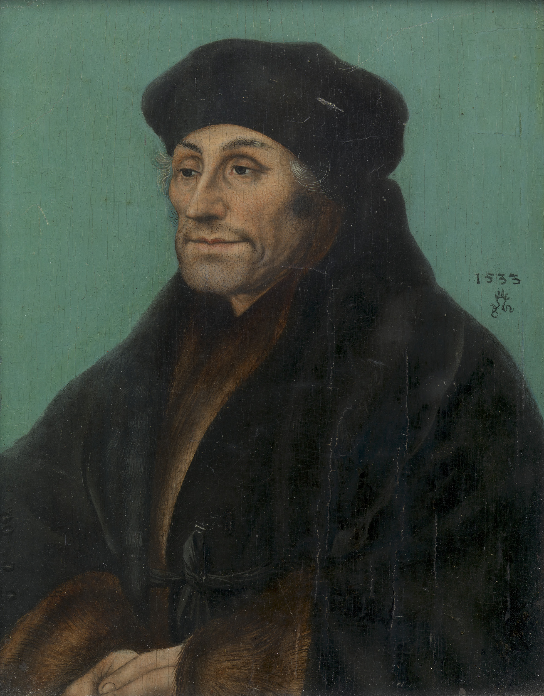

Slide 9
COCHRANE ADAMS
FINE ART AGENTS
Charles Cochrane
charles@cochrane-adams.com
+44 (0)7480 048 688 / +44 (0)203 095 5120
8 Hill Street
London
W1J 5NG
www.cochrane-adams.com

